Slide 1

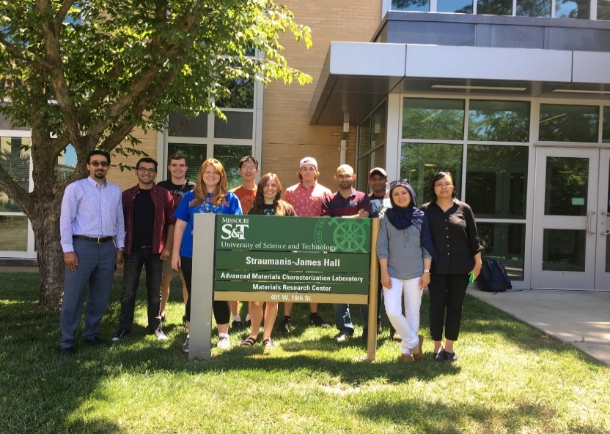

Supervised linear regression machine learning model to predict the primary dendritic arm spacing
Sepideh Kavousi Department of Mechanical Engineering & Materials Science Program
Colorado School of Mines
ZaeemLab.com

Slide 2
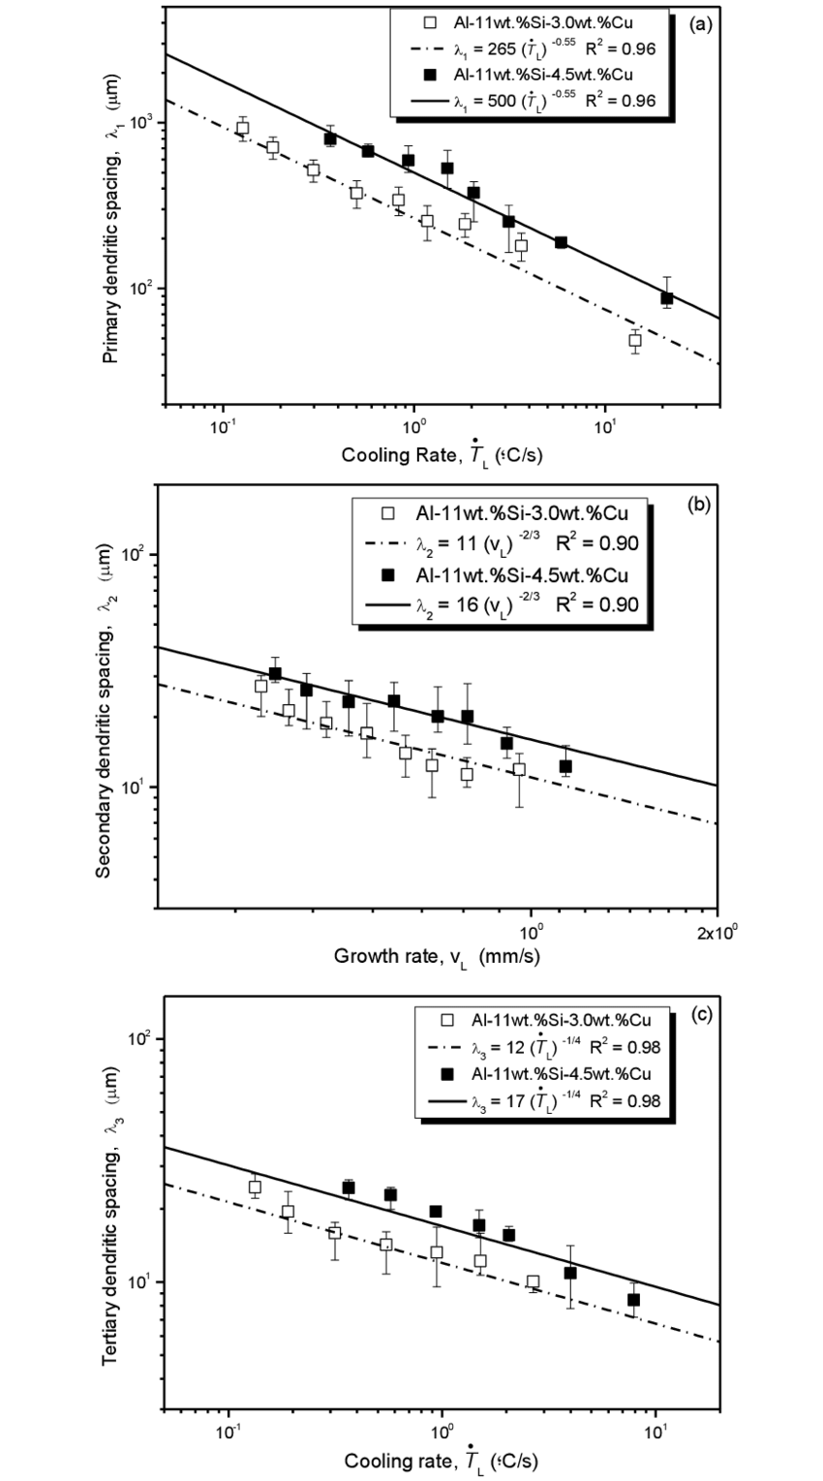


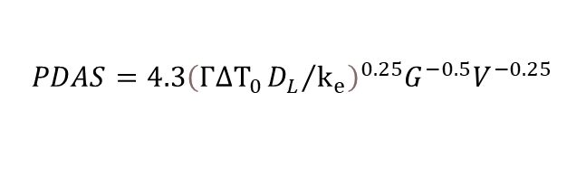
Problem Statement
Analytical Models predicting Primary Dendritic Arm Spacing (PDAS)
$$PDAS=2.83{\left(k_{e}ΓΔT_{0}D_{L}\right)}^{0.25}G^{−0.5}V^{−0.25}$$
Hunt-Burden (HB)
$$PDAS=4.3{\left(ΓΔT_{0}{D_{L}}/{k_{e}}\right)}^{0.25}G^{−0.5}V^{−0.25}$$
Kurz-Fisher (KF)
Analytical relations for PDAS have significant deviations from computational predications and experimental data
Computational PDAS versus analytical models for Si-9at.%As ¹
Experimental PDAS versus analytical models for Al-11Si ²
¹ https://doi.org/10.1016/j.actamat.2020.116562
² https://doi.org/10.3390/met8100784
2

Slide 3
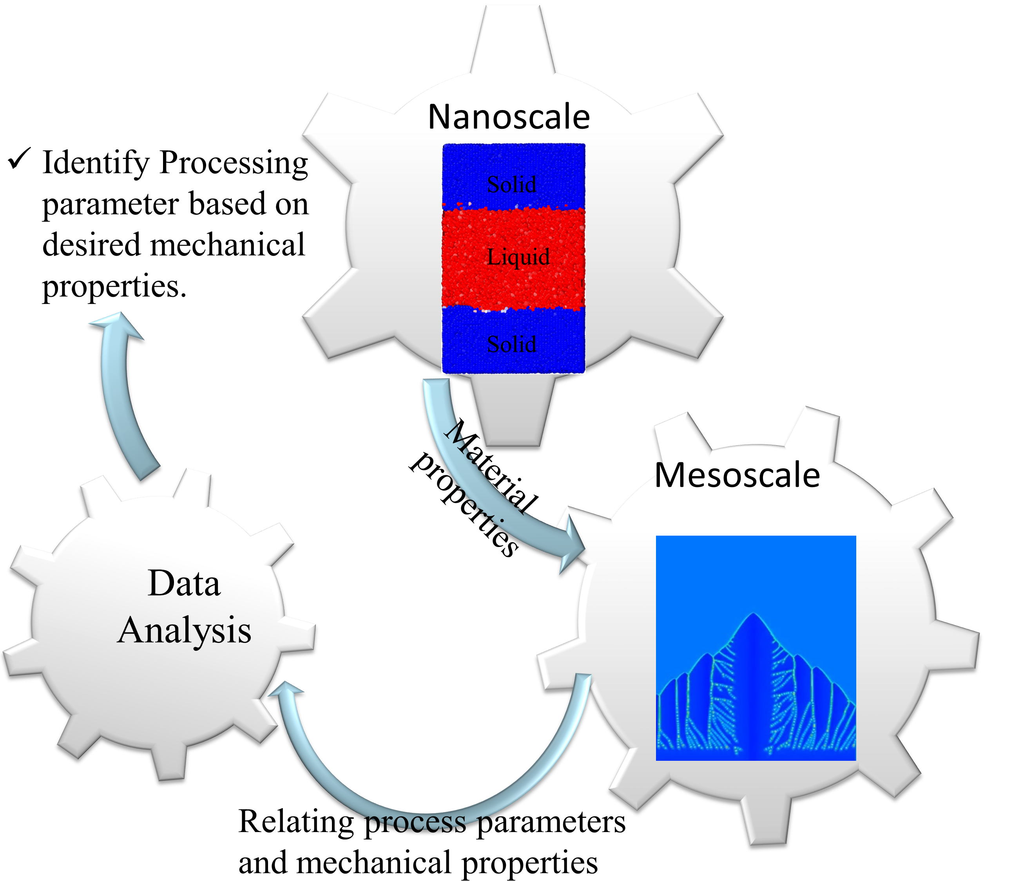
Workflow
FCC system: Ti-X at% Ni ( X=3.4, 7.1, 10.7)
HCP system: Mg-9 at%Al
BCC system: Al-X at%Cu (X=6,8,10)
3

Slide 4
The Computational Data
 | V (m/s) | G (K/m) | Number of data points from PF modeling
Ti-3.4 at% Ni | 0.01-0.09 | 10^{7,} 8×10^{6,} 7×10^{6,} 6×10^{6,} 5×10⁶ | 45
Ti-7.1 at% Ni | 0.01-0.09 | 10^{7,} 8×10^{6,} 7×10^{6,} 6×10^{6,} 5×10⁶ | 42
Ti-10.4 at% Ni | 0.0001-0.02 | 10^{7,} 5×10⁶ | 22
Mg-9 at% Al | 0.005-0.12 | 5×10^{6,} 3×10^{6,} 1×10⁶ | 21
Al-6 at% Cu | 0.001-0.06 | 10^{7,} 8×10^{6,} 7×10^{6,} 6×10^{6,} 5×10⁶ | 47
Al-8 at% Cu | 0.01-0.08 | 10^{7,} 8×10^{6,} 7×10^{6,} 6×10^{6,} 5×10⁶ | 43
Al-10 at% Cu | 0.008-0.005 | 10^{7,} 8×10^{6,} 7×10^{6,} 6×10⁶ | 30
4

Slide 5
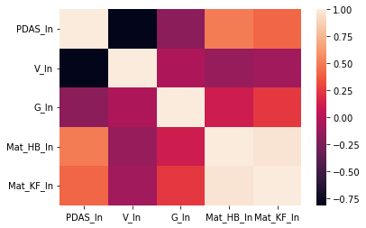
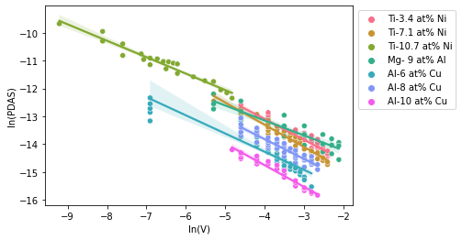
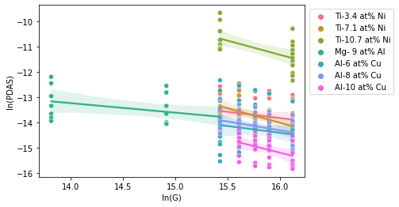


ML model
$$mat_{HB}=k_{e}ΓΔT_{0}D_{L}$$
$$PDAS=A ×V^{α}{ G}^{β} {\left(mat_HB\right)}^{γ}$$
HB Material Properties
KF Material Properties
$$PDAS=A ×V^{α}{ G}^{β} {\left(mat_KF\right)}^{γ}$$
$$mat_{KF}=ΓΔT_{0}{D_{L}}/{k_{e}}$$
$$\ln\left(PDAS\right)=\ln\left(A\right)+α×\ln\left(V\right)+β×\ln\left(G\right)+γ×\ln\left(mat_HB\right)$$
HB Material Properties
$$\ln\left(PDAS\right)=\ln\left(A\right)+α×\ln\left(V\right)+β×\ln\left(G\right)+γ×\ln\left(mat_KF\right)$$
KF Material Properties
5

Slide 6
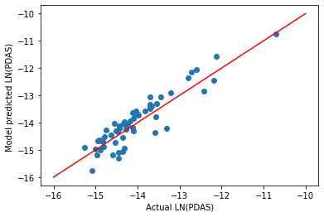
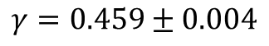
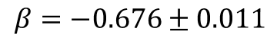
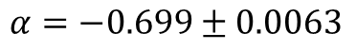
Supervised Machine Learning Linear Regression Model
HB Material Properties
$$PDAS=A ×V^{α}{ G}^{β} {\left(mat_HB\right)}^{γ}$$
$$α=−0.699±0.0063$$
$$β=−0.676±0.011$$
$$γ=0.459±0.004$$
6

Slide 7
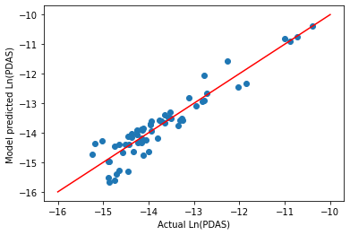
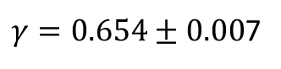
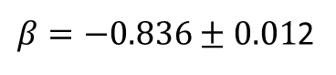
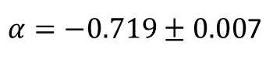
Non-parametrized Regression Model- KB material Properties
KF Material Properties
$$PDAS=A ×V^{α}{ G}^{β} {\left(mat_KF\right)}^{γ}$$
$α=−0.719±0.00$7
$β=−0.836±0.01$2
$γ=0.654±0.00$7
7

Slide 8
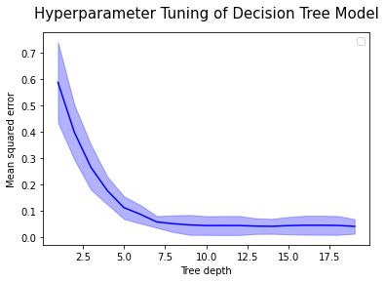
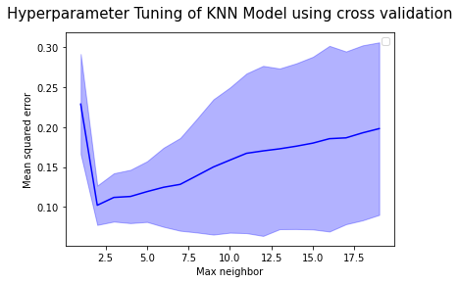
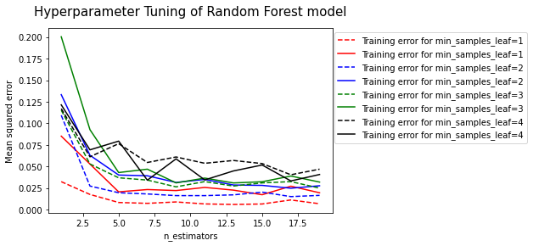
Non-parametrized Regression Models-hyperparameter Tuning
8

Slide 9
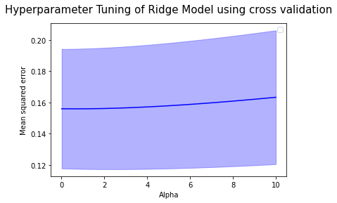
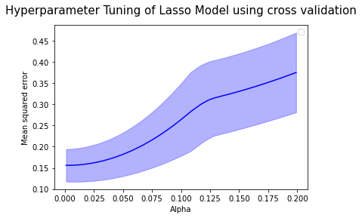
Parametrized Regression Models-hyperparameter Tuning
9

Slide 10
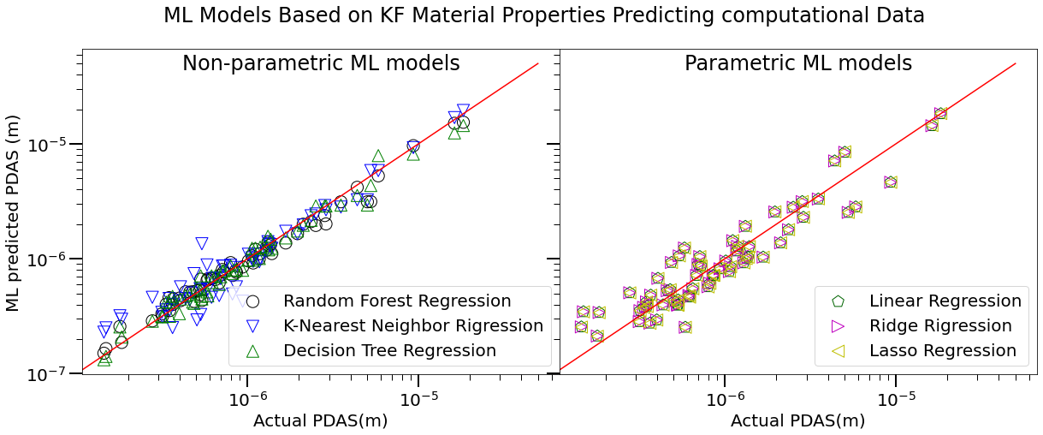
Comparing the Model Predictions of different ML Rigression Models
10

Slide 11
Comparing the Performance of different ML Regression Models-Training Data
11

Slide 12
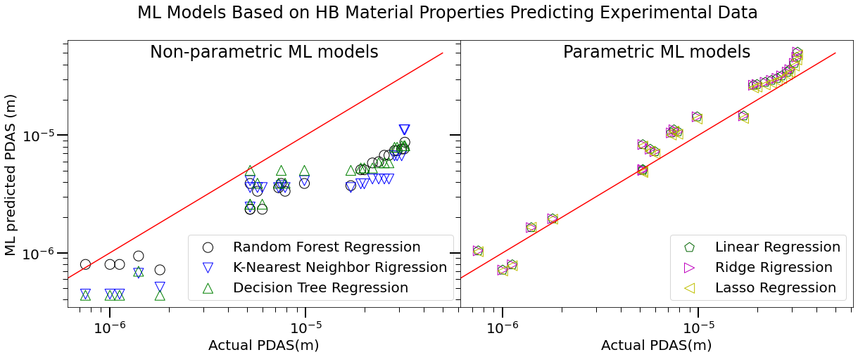
Comparing the Performance of different ML Regression Models-Experimental Data
12

Slide 13
Conclusion
In this project we develop a supervised-regression machine learning model to obtain a correlation between the PDAS and velocity and temperature gradient
We obtain a very important conclusion that in contract to analytical models, where temperature gradient plays much important role in the PDAS estimations, the velocity and temperature play almost equal roles in PDAS correlation!
Fitting the data for the individual alloys were not helpful because we did not put any restriction on how the material properties equation looks like and therefore alpha and beta values seem all around the place.
The performance of non-parametric ML models on testing and training dataset was better.
The performance on parametric ML models on experimental dataset was better
13

Slide 14
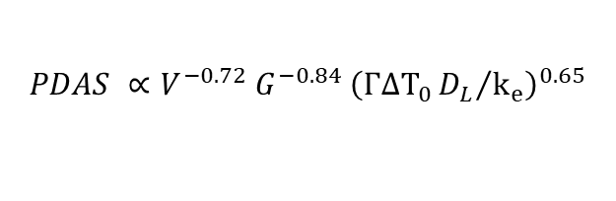

Recommendation
The material scientists are recommended to use the modified-HB and modified-KF models instead of the original analytical HB and KF models.
$$PDAS ∝V^{−0.25}{ G}^{−0.5} {\left(k_{e}ΓΔT_{0}D_{L}\right)}^{0.25}$$
HB model
$$PDAS ∝V^{−0.7}{ G}^{−0.68} {\left(k_{e}ΓΔT_{0}D_{L}\right)}^{0.46}$$
Modified HB model
$$PDAS ∝V^{0−0.25}{ G}^{−0.5} {\left(ΓΔT_{0}{D_{L}}/{k_{e}}\right)}^{0.25}$$
KF model
$$PDAS ∝V^{−0.72}{ G}^{−0.84} {\left(ΓΔT_{0}{D_{L}}/{k_{e}}\right)}^{0.65}$$
Modified KF model
14

